Slide 1
Neural Network
연세대학교 컴퓨터과학과 염찬호
과제명: IoT 환경을 위한 고성능 플래시 메모리 스토리지 기반 인메모리 분산 DBMS 연구개발
과제번호: 2017-0-00477

Slide 2
Content
Feed-forward Network Functions
Network Training
Error Backpropagation
Regularization in Neural Networks
The Hessian Matrix

Slide 3
Feed-forward Network Functions

Slide 4
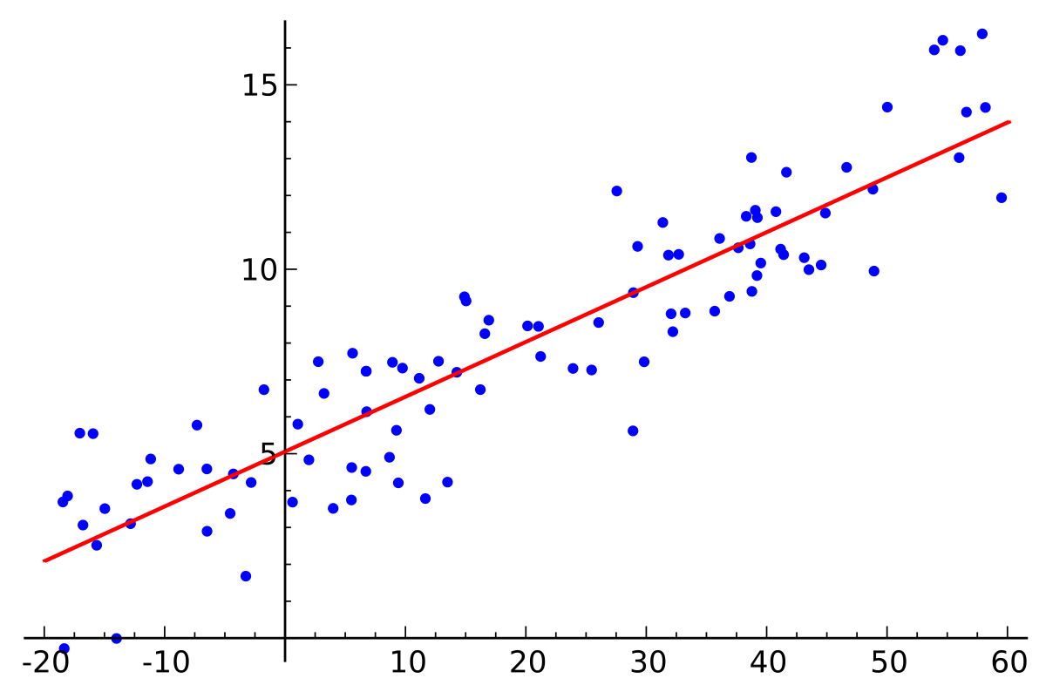
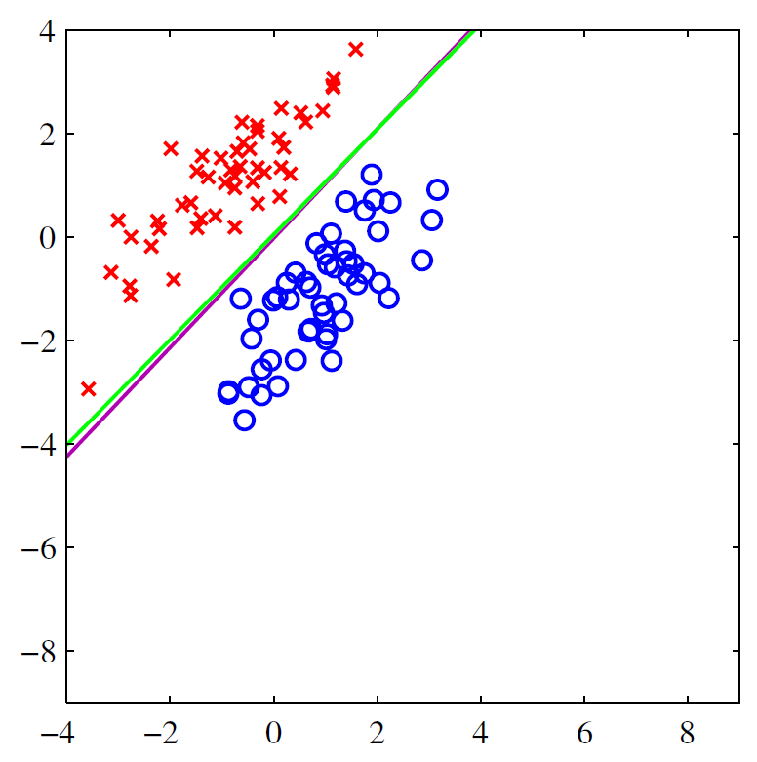
Review
Notes:
The basis function is fixed
Practical applicability limited by the curse of dimensionality

Slide 5
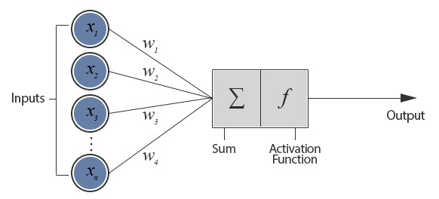
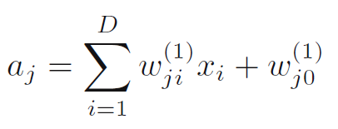
Feed-forward Network Functions
Notes:
the parameters w as weights and the parameters w as biases
aj are known as activations
activation function h(・)

Slide 6
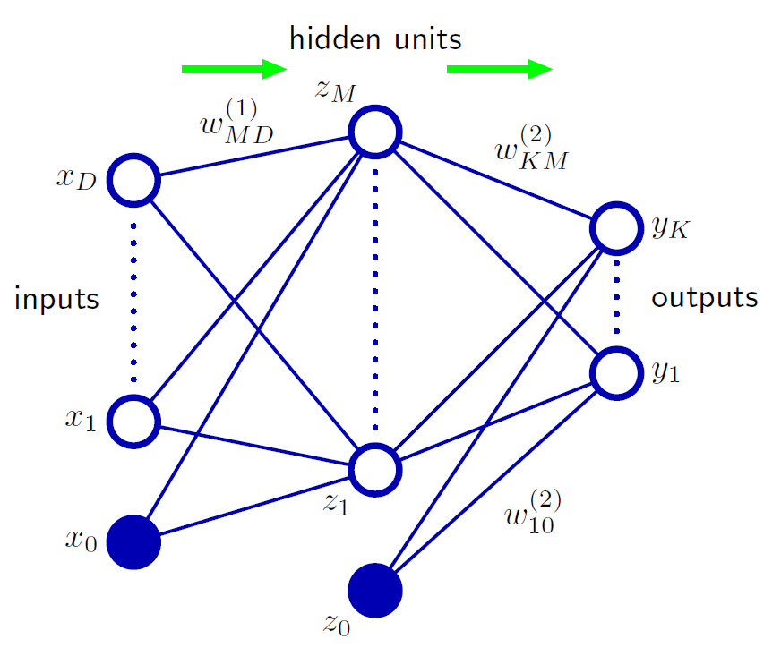
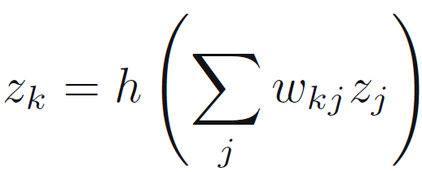
Feed-forward Network Functions
Notes:
the bias parameters can be absorbed into the set of weight parameters by defining an additional input variable x0 whose value is clamped at x0 = 1,

Slide 7
Network Training

Slide 8
Error Function
Multiple target regression problem (sum-of-squares error function)
Single binary classification problem (cross-entropy error function)
Multiclass classification problem

Slide 9
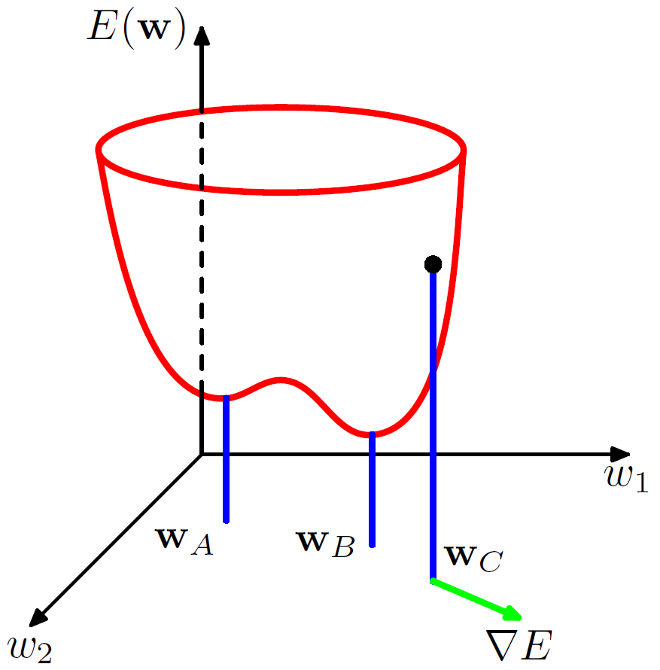
Parameter optimization
Find a vector w that E(w) takes its smallest value
With M hidden units, each point in weight space is a member of M!2M equivalent points
Multiple stationary points and in particular multiple minima
Notes:
For a successful application of neural networks, it may not be necessary to find the global minimum (and in general it will not be known whether the global minimum has been found) but it may be necessary to compare several local minima in order to find a sufficiently good solution.

Slide 10
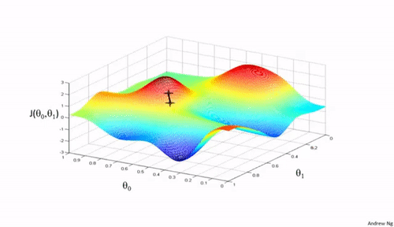
Iterative numerical procedures
Choosing some initial value w(0) for the weight vector
Notes:
N: learning rate

Slide 11
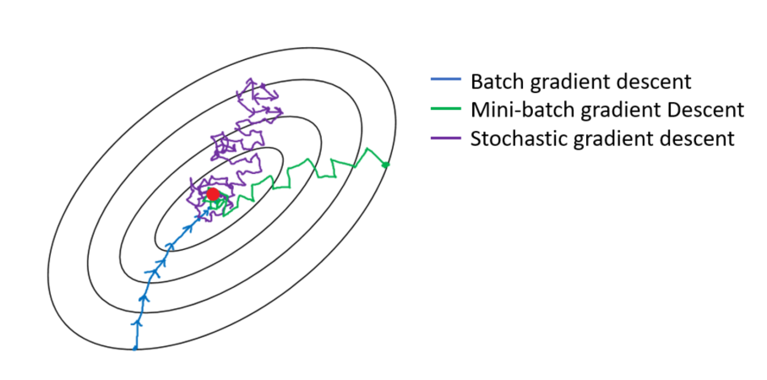
Gradient Descent Optimization
The error function is defined with respect to training set, so each step requires the entire training set be processed in order to evaluate ∇E
Batch gradient descent: each step requires entire training set
Stochastic gradient descent: each step requires one data point
Notes:
One advantage of on-line methods is that handle redundancy in the data much more efficiently
Another property of on-line gradient descent is the possibility of escaping from local minima

Slide 12
Error Backpropagation

Slide 13
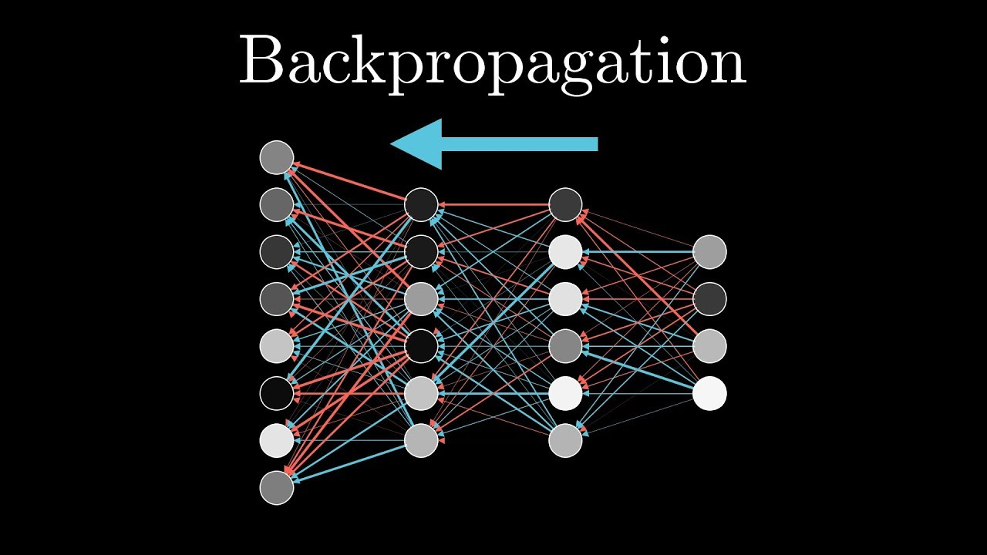
Error Backpropagation
Evaluated the derivatives of the error function with respect to the weights
Use the derivatives to compute the adjustments of the weights

Slide 14
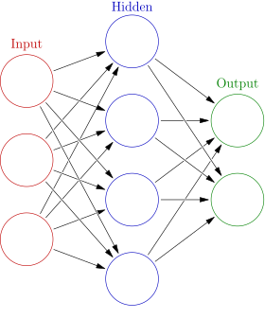
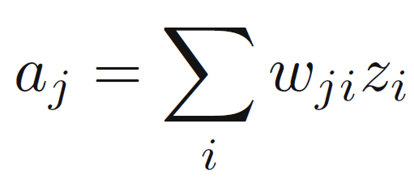
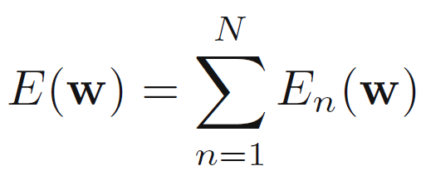
Evaluation of error-function derivatives

Slide 15
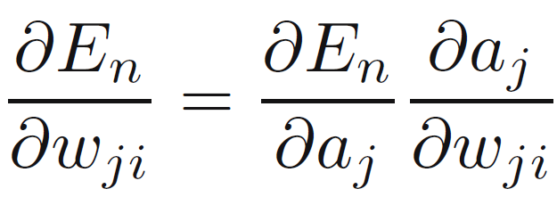
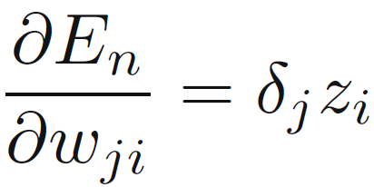
Evaluation of error-function derivatives

Slide 16
Evaluation of error-function derivatives

Slide 17
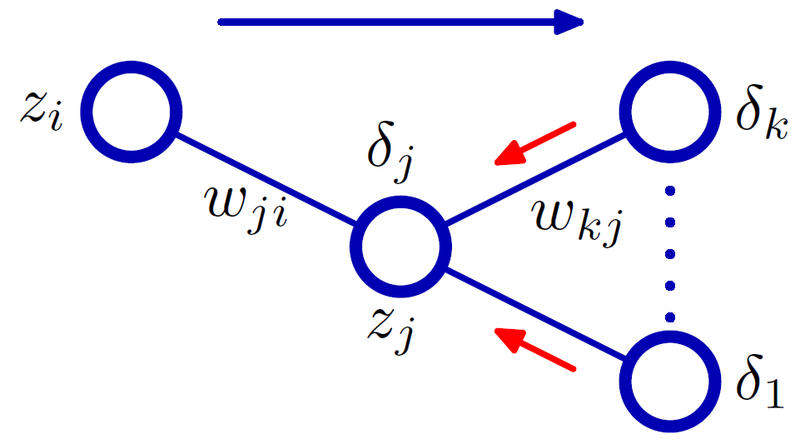
Evaluation of error-function derivatives

Slide 18
Evaluation of error-function derivatives
Apply an input vector x_{n} to the network and forward propagate through the network:
To find the activations of all the hidden and output units.
Evaluate the δk for all the output units.
Backpropagate the δ’s to obtain δj for each hidden unit in the network.
Evaluate the required derivatives.
O(W)

Slide 19
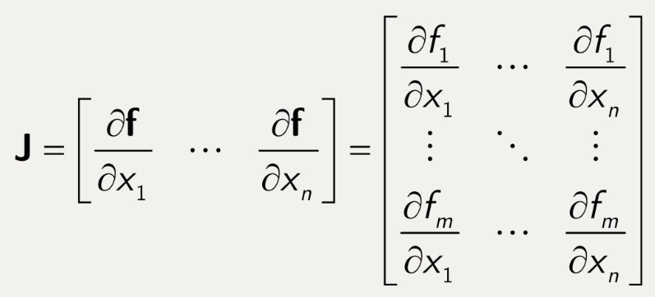
The Jacobian matrix

Slide 20
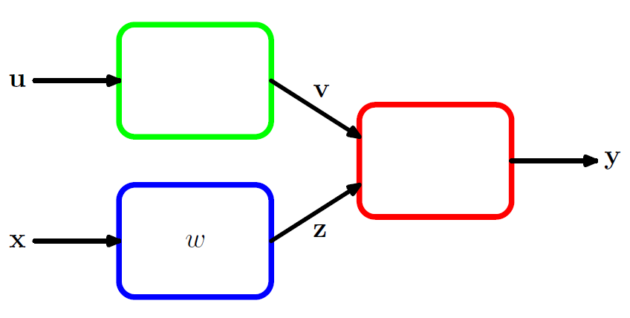
The Jacobian matrix

Slide 21
Regularization in Neural Networks

Slide 22
Effect of M
Number of input and outputs units in a neural network is generally determined by the dimensionality of the data set
Number M (complexity) of hidden units is a free parameter

Slide 23
Consistent Gaussian priors
The effective model complexity determined by the choice of the regularization coefficient λ.
inconsistent with certain scaling properties of network mappings.
Notes:
this regularizer can be interpreted as the negative logarithm of a zero-mean Gaussian prior distribution over the weight vector w.

Slide 24
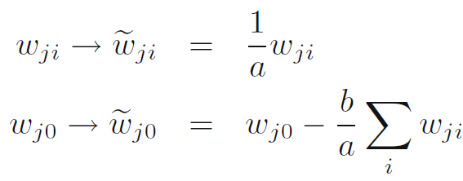
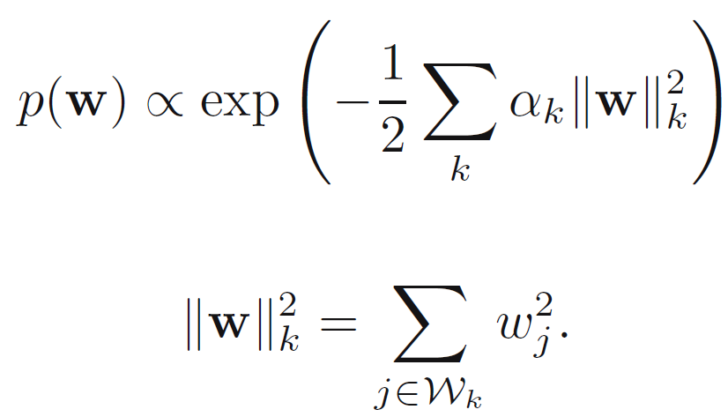
Consistent Gaussian priors
Notes:
this regularizer can be interpreted as the negative logarithm of a zero-mean Gaussian prior distribution over the weight vector w.

Slide 25
Early stopping
Early stopping exhibit similar behavior to using a simple weight-decay term

Slide 26
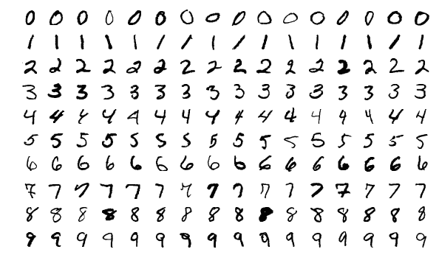
Invariances
predictions should be invariant, under one or more transformations of the input variables.
training set: large number of examples of the various transformations

Slide 27
Invariances
Augmentation: using replicas of the training patterns, transformed according to the desired invariances
Regularization term: penalizes changes in the model output when the input is transformed
tangent propagation
Extracting features: extracting features that are invariant under the required transformations
Build the invariance properties into the structure of a neural network
convolutional networks

Slide 28
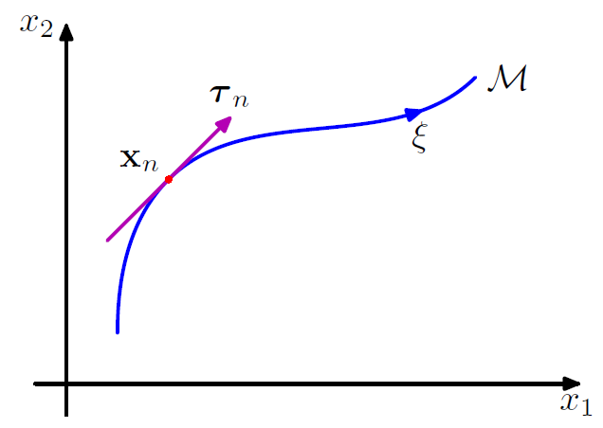
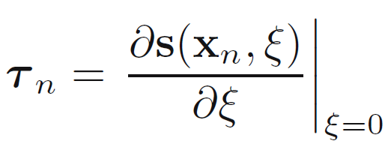
Tangent propagation
Given a continuous transformation s(x_{n}, ξ) to input vector x_{n}

Slide 29
Tangent propagation
Given a continuous transformation s(x_{n}, ξ) to input vector x_{n}

Slide 30
Convolutional networks
Nearby pixels are more strongly correlated than more distant pixels
Notes:
extracting local features that depend only on small subregions of the image. Information from such features can be merged in later stages of processing in order to detect higher-order features
Also, local features that are useful in one region of the image are likely to be useful in other regions of the image

Slide 31
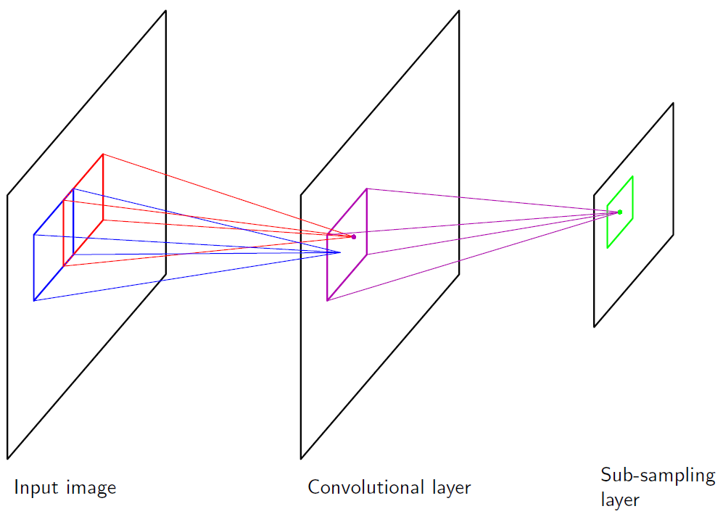
Convolutional networks
local receptive fields
weight sharing
subsampling
Notes:
One conv layer according to one feature
Subsampling: the response of a unit in the subsampling layer will be relatively insensitive to small shifts of the image in the corresponding regions of the input space.
In a practical architecture, there may be several pairs of convolutional and subsampling layers.
At each stage there is a larger degree of invariance to input transformations compared to the previous layer

Slide 32
The Hessian Matrix

Slide 33
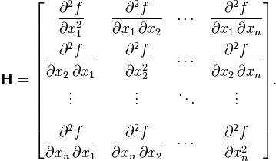
The Hessian Matrix
Several nonlinear optimization algorithms based on the second-order properties of the error surface
The basis of a fast procedure for re-training a network following a small change in the training data
The inverse of the Hessian used to identify the least significant weights in a network

Slide 34
Evaluating the hessian matrix
Diagonal approximation
Replaces the off-diagonal elements with zeros
In practice the matrix is strongly nondiagonal
Outer product approximation
develop a computationally efficient procedure for approximating the inverse of the Hessian
only likely to be valid for a network that has been trained appropriately
Exact evaluation of the Hessian
Use an extension of the backpropagation technique
The number of computational steps O(W²)

Slide 35
Q&A

